Slide 1
Sample Store Analysis
Done By : Chandra Prakash Mewari

Slide 2
Sample Store Columns:
Ship Mode : Under Different Class
Segment : Different Segments of Users.
Country : Types of Country
City : Types of City
State : Types of State
Postal Code: Under Various City Postal Code
Category : Different Types Of Store Categories
Sub-Category : Under Various Sub Categories
Sales : Different Sales By Store
Quantity : Number of Quantity That are saled or Left
Discount : Discount Price of that was Given By Store
Profit : Under there Different Profits.

Slide 3
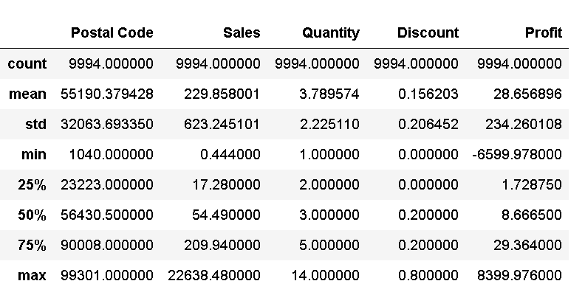
Shape and Description of the data :
It Contains 9994 rows, 13 Columns.

Slide 4
Ship Mode Count
Standard Class has 5968 Count Among other Class

Slide 5
Segment Count
In there Consumer Were More Among 5191 among all the other Segments

Slide 6
Country By States:-

Slide 7
Observation:-
In the Previous Chart Shows Under United States There are Multiple City and its Count
It Also Show Maximum Transaction or sale From Nobels Ville.

Slide 8
State Count:-
Sate Count of Different State

Slide 9
Region Count :-
Different Region Count west were More 32%

Slide 10
Types of Categories :-

Slide 11
Categories and Sub-Categories Count:-

Slide 12
Profit By Region :

Slide 13
Region Where Less Profit:-

Slide 14
Conclusion:
Need to Be Work on Different Region by Some Percentage.
Increase Quantity or Discount Make Store More Profitable.

Slide 15
xddd
THANK YOU

